Slide 1
Going Global: Deploying Our Application Around the World with Lambda and Global Tables

Slide 2
A DynamoDB Table Lives in One Region, What If Our Application Is Global?

Slide 3
Global Tables
Lots of applications are global

Slide 4
Global Tables
Lots of applications are global
Having your application make cross-region calls to a centralized DynamoDB database, adds latency

Slide 5
Global Tables
Lots of applications are global
Having your application make cross-region calls to a centralized DynamoDB database, adds latency
This results in slower responses and a poorer user experience

Slide 6
Global Tables
Lots of applications are global
Having your application make cross-region calls to a centralized DynamoDB database, adds latency
This results in slower responses and a poorer user experience
Global tables solves this problem by providing replicas of your data

Slide 7
Multi-region, Multi-master for Fast Local Performance for Distributed Apps
Global tables automatically replicate data across your choice of AWS regions, giving you a local table in region for your application to connect to

Slide 8
Multi-region, Multi-master for Fast Local Performance for Distributed Apps
Global tables automatically replicate data across your choice of AWS regions, giving you a local table in region for your application to connect to
Leverages DynamoDB streams for synchronizing changes between tables

Slide 9
Multi-region, Multi-master for Fast Local Performance for Distributed Apps
Global tables automatically replicate data across your choice of AWS regions, giving you a local table in region for your application to connect to
Leverages DynamoDB streams for synchronizing changes between tables
Global tables is a master-master model, which means you can write to or read from any endpoint

Slide 10
Multi-region, Multi-master for Fast Local Performance for Distributed Apps
Global tables automatically replicate data across your choice of AWS regions, giving you a local table in region for your application to connect to
Leverages DynamoDB streams for synchronizing changes between tables
Global tables is a master-master model, which means you can write to or read from any endpoint
Changes are synchronized in an eventually consistent fashion

Slide 11
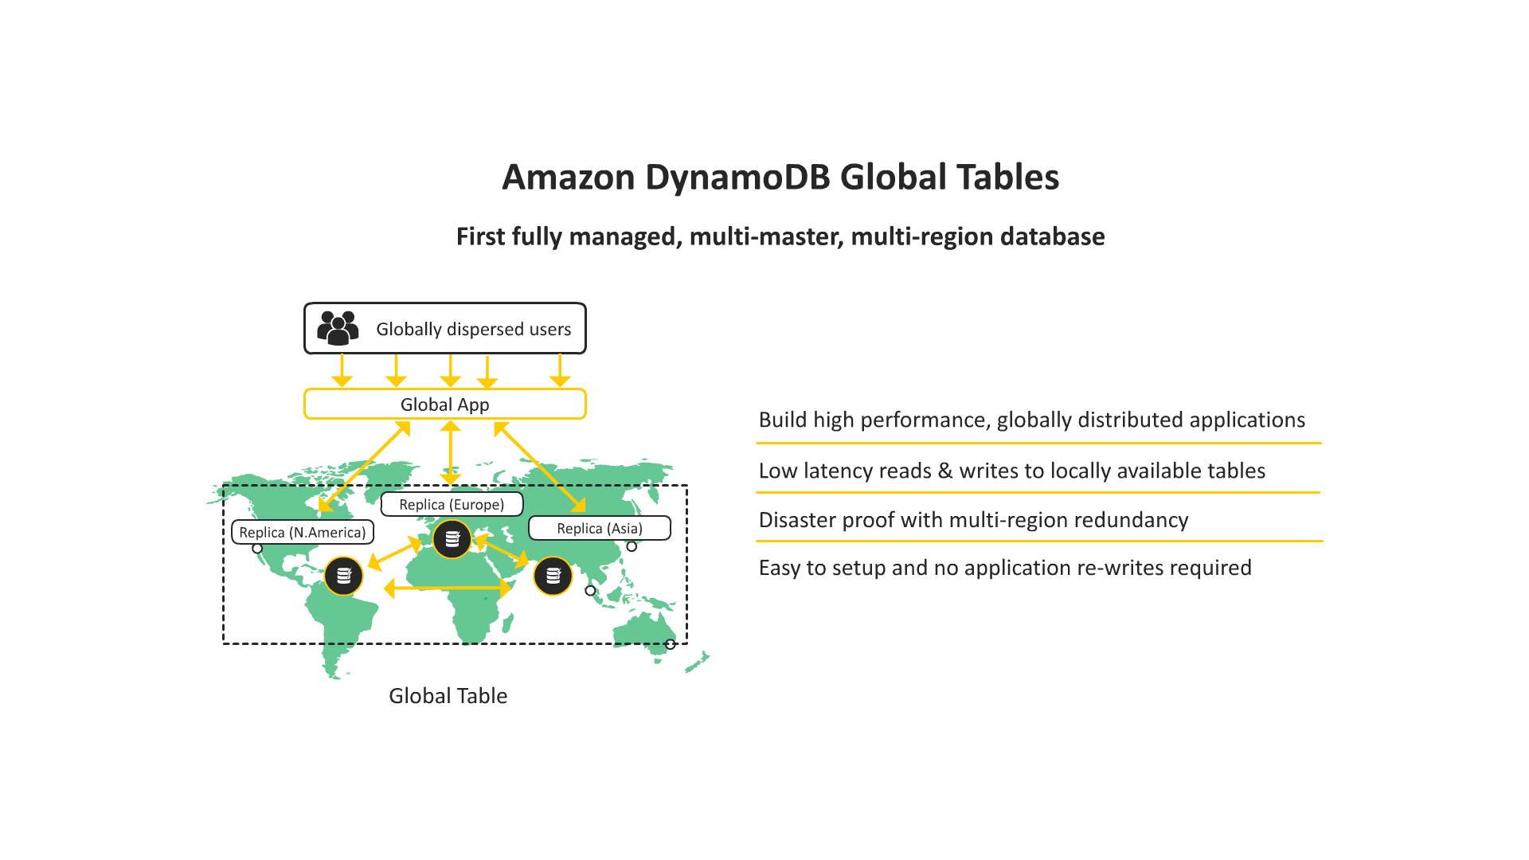
Global Resiliency

Slide 12
Integrate with Lambda for a Truly Global DR Solution
AWS Lambda already manages resiliency across all AZs in a single region

Slide 13
Integrate with Lambda for a Truly Global DR Solution
AWS Lambda already manages resiliency across all AZs in a single region
If you perform a global deployment, where Lambda is your application compute layer along with DynamoDB global tables, you have a truly global highly available solution

Slide 14
Integrate with Lambda for a Truly Global DR Solution
AWS Lambda already manages resiliency across all AZs in a single region
If you perform a global deployment, where Lambda is your application compute layer along with DynamoDB global tables, you have a truly global highly available solution
The failure of a single or multiple availability zones or regions would not result in any down time
Another region would simply pick up the load and scale out transparently as required

Slide 15
Requirements for Global Tables
The table must have the same partition key as all of the other replicas

Slide 16
Requirements for Global Tables
The table must have the same partition key as all of the other replicas
The table must have the same write capacity management settings specified

Slide 17
Requirements for Global Tables
The table must have the same partition key as all of the other replicas
The table must have the same write capacity management settings specified
The table must have the same name as all of the other replicas

Slide 18
Requirements for Global Tables
The table must have the same partition key as all of the other replicas
The table must have the same write capacity management settings specified
The table must have the same name as all of the other replicas
The table must have DynamoDB Streams enabled, with the stream containing both the new and the old images of the item

Slide 19
Requirements for Global Tables
The table must have the same partition key as all of the other replicas
The table must have the same write capacity management settings specified
The table must have the same name as all of the other replicas
The table must have DynamoDB Streams enabled, with the stream containing both the new and the old images of the item
None of the replica tables in the global table can contain any data

Slide 20
Capacity Planning Can Be Tricky
Remember each table needs sufficient WCUs to apply all writes from all regions combined

Slide 21
Capacity Planning Can Be Tricky
Remember each table needs sufficient WCUs to apply all writes from all regions combined
Instead of worrying about this, it is best to either use auto scaling or the on-demand capacity model

Slide 22
Capacity Planning Can Be Tricky
Remember each table needs sufficient WCUs to apply all writes from all regions combined
Instead of worrying about this, it is best to either use auto scaling or the on-demand capacity model
Both of these approaches allow your table to scale transparently and respond automatically to demand

Slide 23
Building a Data Cache with DynamoDB and TTL
Next Section

